Slide 1
Module 3
Digital Physical health
www.digiworkwell.eu

Slide 2
Content of Module 3
01
Impact of Digital Use on Physical Health
02
Risk assessment
03
Working environment and ergonomics
04
Spontaneous physical activity
05
Targeted physical activity
06
Case studies
07
Sources and exercises
08
Summary/ quiz

Slide 3
Welcome to the DigiWorkWell Training Course
Welcome to the Digital Physical Health course. This course will familiarise you with the potential hazards of working with a computer and provide you with efficient strategies on how to minimise them. Moreover, you will learn simple yet effective ways to maintain your well-being while working in an office environment.
3

Slide 4
SECTION
01
Impact of Digital Use on Physical Health

Slide 5
Introduction to the topic: office work and its impact on physical health
Office work is inextricably linked with a predominantly sedentary lifestyle during the day and a general reduction in physical activity. All available sources point to the drastic effects of such a lifestyle. Too much sitting can increase the risk of ischemic heart disease, cancer, type 2 diabetes or stroke, among other diseases. Moreover, sedentary workers are also shown to experience a higher prevalence of psychological problems, mood deterioration and sleep issues.
Prolonged sedentary behaviour can weaken the musculoskeletal system, resulting in spinal and joint pain, a decrease in physical fitness and an increased rate of degenerative changes.
Physical inactivity is the fourth leading risk factor for mortality worldwide, accounting for 6% of global mortality.
World Health Organization. Global recommendations on physical activity for health. Geneva: World Health Organization; 2010.

Slide 6
The dangers of a sedentary lifestyle can cause consequences at both the individual and organisational levels
Individual | Organization
reduced quality of life deterioration of emotional state increased risk of premature death decreased psychosocial functions decreased work efficiency | increased cost of employee maintenance disorganisation of the team's work increased risk of project delays decreased efficiency of the team's work

Slide 7
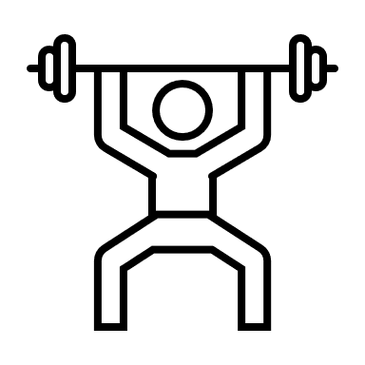
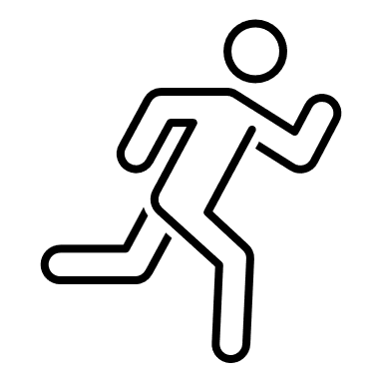
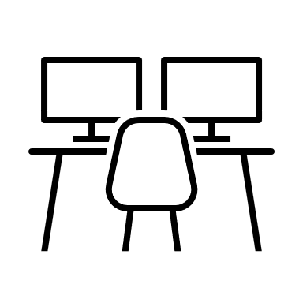
What is the prevention?
Fortunately, the current state of knowledge allows us to effectively reduce the risks associated with a sedentary lifestyle. We can distinguish three main pillars of prevention:
compensating for the negative effects of sitting with targeted physical activity
increasing spontaneous physical activity
minimising the effects of a sedentary lifestyle (workstation ergonomics)

Slide 8
SECTION
02
Risk assessment

Slide 9
Individual Lifestyle Assessment Sheet
Complete the quiz below to assess the risk of health consequences of your lifestyle:
I work most often in a sedentary position.
I spend more than 2 hours a day in my car.
I walk less than 4,000 steps (35 minutes) per day.
I spend leisure time sitting (in front of a computer/TV /reading, etc.) for a minimum of 4h a day.
My BMI exceeds 25 (check your BMI here).
I smoke cigarettes regularly.
I engage in less than 150 minutes of moderate-intensity aerobic physical activity (e.g., running, Nordic-walking, cycling, dancing, etc.) per week.
I strength train (with external resistance or my own body) less than 2 times a week.
When working out with DSE, I take breaks less than once an hour.
Ultra-processed foods are present in my regular diet.

Slide 10
Individual Lifestyle Assessment Sheet
0-1 x YES: You are on the right track. Take care to maintain your healthy habits.
2-3 x YES: Some issues in your lifestyle need improvement. Small changes can yield significant improvements in your health.
4+ YES: You need a thorough change in your health habits. Implementing them will significantly reduce the risk of lifestyle diseases and premature death. If you feel you can't handle them on your own, consult a specialist.
The sheet has been prepared based on WHO, NIH, HSE materials and publications:
Ding, D., Gebel, K., Phongsavan, P., Bauman, A. E., & Merom, D. (2014). Driving: a road to unhealthy lifestyles and poor health outcomes. PloS one, 9(6), e94602. Park, J. H., Moon, J. H., Kim, H. J., Kong, M. H., & Oh, Y. H. (2020). Sedentary Lifestyle: Overview of Updated Evidence of Potential Health Risks. Korean journal of family medicine, 41(6), 365–373.

Slide 11
SECTION
03
Working environment and ergonomics

Slide 12
First – healthy habits
Make sure to take frequent breaks, no less than once an hour. Stand up from your desk, move around, and perform the exercises you will learn later in the course - the more often, the better.
Get the muscles responsible for the eye's accommodation in motion - during breaks from work, look out the window into the distance, expose yourself to natural light for a while. A gentle eye massage can also bring relief to your eyes (you can find instructions for safe eye self-massage here). It's also a good idea to blink a little during breaks.
If you're having a particularly stressful time at work, make a point to regularly perform short exercises that will not only help reduce the stress you're feeling, but also take the tension out of your body. Short breathing exercises, which you will learn about later in this course, will be an excellent idea.
TIP: If you forget to take breaks, use one of the break reminder apps, or set a recurring reminder on your phone. It's a simple method that really works.
TIP: Follow the 20-20-20 rule – look 20 feet away (6 meters) for 20 seconds every 20 minutes.

Slide 13
Second - appropriate workstation
The desk at which you work should provide enough space to comfortably place the documents and computer equipment you need for work. The desk should not reflect light.
Ensure that there is space between the keyboard and the edge of the desk for your forearms. Place the keyboard in front of you.
Pay attention to the appropriate amount of space to operate the mouse. Initially, the mouse should be in line with your elbow.
The monitor should be positioned in front of you, so that its top edge is at eye level. If you use a laptop computer, consider using an external monitor, or set the laptop monitor at a suitable height and use an external keyboard and mouse to operate it.
Pay attention to adequate lighting, allowing you to work comfortably (see documents and keyboard well). Light sources should not be aimed directly at your vision, nor should they cause reflections on the screen.

Slide 14
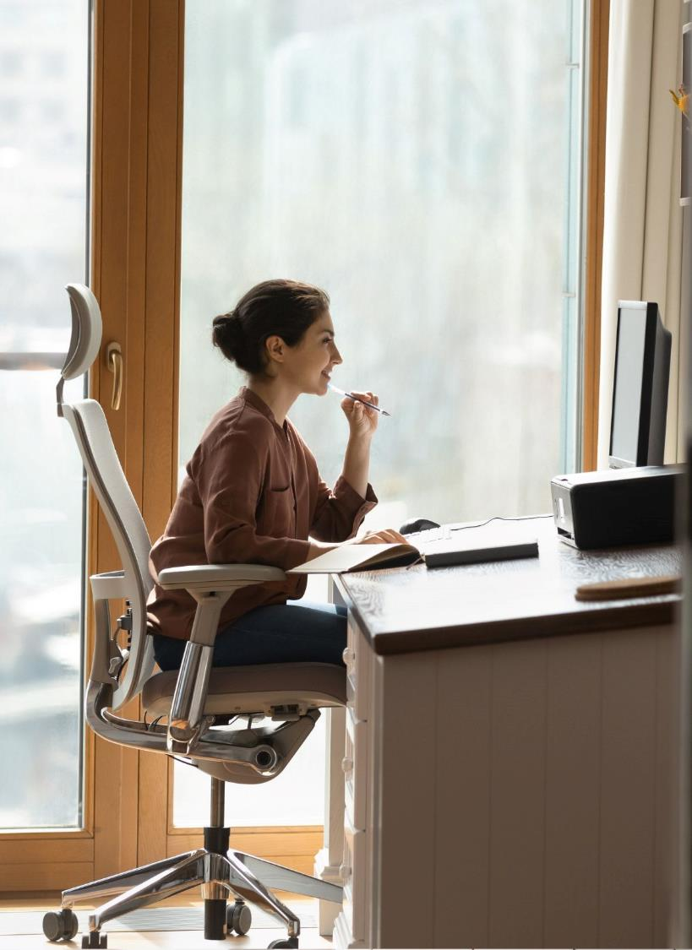
Third - sit well
Your shoulders should be relaxed. If you feel tension in the neck area, your desk is probably too high.
Your office desk should be positioned so that the keyboard is slightly below your elbows.
If your chair has armrests, you should be able to rest your elbows on them comfortably while working at your desk.
The back of your chair should support your lower back.
Set your seat height so that the front and back of your thighs are evenly weighted and your feet are free to stand on the floor.
There should be 2-3cm of space between your lower back and the edge of the seat.
The chair you sit on should be stable.

Slide 15
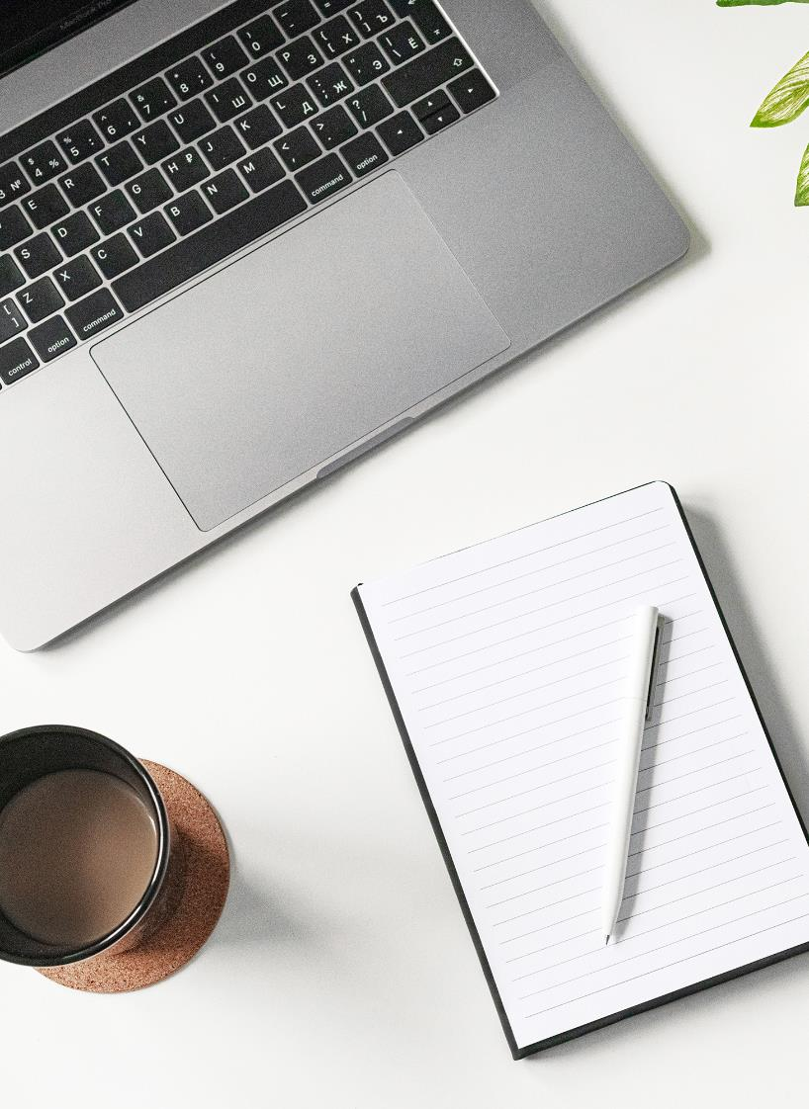
Fourth - adjust your equipment
The text displayed on the screen should be easily readable. Adjust colors, contrast and font size if you have trouble reading the displayed text. The size of the monitor should be sufficient to comfortably perform the activities you are undertaking.
Work only on fully operational equipment. Flicker and jitter indicates a need for repair.
Adjust the speed of the mouse cursor so that you can comfortably operate the entire workspace.

Slide 16
Evaluate your workplace!
To assess potential problems lying in your workstation, you can use the DSE Workstation Checklist prepared by the British Health and Safety Executive.

Slide 17
SECTION
04
Spontaneous physical activity

Slide 18
Spontaneous physical activity
Spontaneous physical activity is the easiest way to reduce the risk of many of the most common ailments that occur as a result of prolonged sitting. Any physical activity that is not a scheduled workout will induce Non-Exercise Activity Thermogenesis - NEAT. This is the amount of energy we use to perform all physical activities during the day. Studies show that a high NEAT not only reduces the risk of overweight and obesity, but also correlates with a reduced risk of cardiovascular disease, musculoskeletal problems and even cancer.
In people who do sedentary work, NEAT is up to 3 times lower than in those who do physical labor. This result can be significantly improved by introducing small habits to work.

Slide 19
Active breaks
As previously stated, taking regular breaks from office work is crucial to maintaining good health. The more physical activity you engage in during these breaks, the greater the benefits to your body. Use your breaks for any available movement - step outside the building, do a few bends and squats, do your favorite stretching exercise.
Don't ignore small activities. The theory of aggregating marginal gains has excellent application in increasing NEAT. One trip to the other end of the hallway to get water means little, but repeated several times throughout the day will significantly increase your overall activity level.

Slide 20
Consider
What can you change in your routine at work to increase your overall activity level? Maybe instead of a pitcher of water, keep a glass at your desk, so you'll have to walk to refill it more often? Or maybe instead of drinking coffee next to the coffee machine, walk with a cup in front of the building?
Make a note of your answers and choose one action that you will implement immediately. Add further changes every three weeks - give yourself time to develop habits.

Slide 21
Conscious choices to increase NEAT
Take a walk!
Walk wherever you can, get off the bus a stop earlier, take the stairs instead of the elevator, go for a walk to listen to a podcast instead of watching a TV show. Walking is the foundation of non-workout physical activity.
Choose a bicycle instead of a car
Driving to work by car not only reduces overall physical activity levels, but also increases the daily amount of harmful sitting.
Look for a hobby that gets you moving
Working in the garden, picking mushrooms, geocaching - make movement fun!
Every increase of steps by 1000 steps/day is associated with a 15% reduction in the risk of dying from any cause, and every increase by 500 steps/day is associated with a 7% reduction in dying from cardiovascular disease.*
*"The association between daily step count and all-cause and cardiovascular mortality: a meta-analysis," by Maciej Banach et al. European Journal of Preventive Cardiology.

Slide 22
Technology to increase NEAT
There are technological solutions available on the market that effectively help increase NEAT:
Smartwatches and smartbands
Modern wearables no longer just count your steps, but also use advanced sensors to monitor your physical activity. As a result, they can give you personalised tips, remind you to take a break, or offer challenges to motivate you to move.
Standing desks
Movable desks are a great option to take care of your health without taking a break from work. With the touch of a button, we can quickly change the height of our desk so that we can work standing up, avoiding harmful sitting. And when we get tired, a short moment is all it takes for the desk to return to a configuration that allows sedentary work.
Under Desk Treadmills
Devices in this category will allow you to walk while you work. They are quiet and don't take up much space - they will easily fit under your desk. Paired with a standing desk, they allow you to walk slowly while working at your computer.

Slide 23
05
Targeted physical activity

Slide 24
Physical activity and health
As you've probably noticed by now, the best thing you can do for health prevention with a sedentary lifestyle is to increase your overall level of physical activity. Why is this?

Slide 25
Cardiovascular perspective
From a cardiovascular and broader metabolic health perspective, reduced NEAT is associated with reduced levels of daily energy expenditure, which promotes obesity.
A deficiency in exercise also means poorer blood circulation, which is associated with impaired nutrition of drainage of waste products from the body. Less efficient blood circulation also negatively affects brain function.
When sitting, the diaphragm does not move to the full extent, so we breathe less efficiently. In the long term, this can lead to disorders of the breathing pattern and, consequently, reduced respiratory efficiency. Breathing pattern dysfunctions are also associated with impaired stress tolerance.
You can check your breathing pattern with Breathing Pattern Assessment Sheet.

Slide 26
Musculoskeletal perspective
From a musculoskeletal perspective, physical activity allows muscles to maintain their efficiency.
When we sit, most of the muscles in the body are not used, and they become weaker as a result. From the age of 30, catabolic (muscle breakdown) processes begin to dominate over anabolic (muscle formation) processes. Disuse of muscle tissue significantly increases the rate of this process. As a result of immobility, tendons and ligaments are also weakened.
Having weak muscles can lead to increased fatigue of the peripheral joints and spine and pain resulting from overloaded joints not supported by adequate muscle strength. An inefficient musculo-fascial system is also associated with an increased risk of orthopaedic injury, as in the event of an accident, the muscles will not be strong enough to protect the bones and joints.

Slide 27
Back pain
When discussing the issue of sedentary lifestyles, the most common health problem of sedentary workers - back pain - cannot be overlooked. We can distinguish between the two most common causes of back pain:
1. Insufficient nutrition of the intervertebral discs
2. Degenerative changes within the spine
By understanding the mechanism of both of these causes of pain, you will be able to avoid it more easily.

Slide 28
Insufficient nutrition of intervertebral discs
The intervertebral discs separating individual vertebrae in the spine are a unique structure in our body. This is because they are very poorly supplied with blood - the vast majority of their surface has no vascularization - blood vessels cover only their edges. Nutrients enter by diffusion and are distributed deep into the intervertebral discs.
It is essential to keep the spine mobile to enable it to be nourished effectively. Deteriorated intervertebral disc metabolism as a result of spinal immobility promotes degenerative changes in the long term, and in the short term leads to a decrease in pH within the intervertebral discs. This causes series of mechanisms leading to the sensation of pain. The pain experienced during prolonged sitting is an alarm informing us that the spine needs to be put into motion.
28

Slide 29
Degenerative changes in the spine
If we chronically neglect the health of the spine, a number of degenerative changes can occur within it. Two such changes are degeneration of the intervertebral disc, or degeneration of the joints connecting individual vertebrae. The onset of degenerative changes is particularly influenced by two factors:
1. Lack of nutrition of the tissues that make up the spine described earlier.
2. Chronic overloading of the spine in a non-physiological way as a result of muscle imbalance .
The spine is a strong structure, capable of carrying heavy loads, provided that it works under biomechanically optimal conditions. These can only be achieved through efficient, co-ordinated muscle work.
29

Slide 30
Degenerative changes in the spine
Sitting weakens the gluteal and core muscles in particular, but to maintain a healthy, functional spine, muscle balance must be maintained throughout the body.
Every body is different. To protect your health as effectively as possible, consult a physiotherapist to identify your weak links and learn exercises to get rid of them.
Even if the spine is already irreversibly damaged (degenerative changes cannot be reversed - we can only limit their development), in most cases the most effective method of therapy will be the implementation of targeted therapeutic exercises under the guidance of a specialist.

Slide 31
What is an appropriate level of activity?
To answer this question, it is worth looking at the WHO guidelines. The WHO recommends the following portion of physical activity on a weekly basis:
minimum of 150-300 minutes of moderate intensity aerobic activity or 75-150 minutes of moderate to high intensity aerobic activity
muscle strengthening exercises of moderate or high intensity at least 2x per week
for people who are not very sedentary.

Slide 32
What is an appropriate level of activity?
The WHO Guidelines on levels of physical activity states:
“To help reduce the detrimental effects of high levels of sedentary behaviour on health, adults should aim to do more than the recommended levels of moderate to vigorous-intensity physical activity.”
If you have a sedentary job, a high level of physical activity is recommended to avoid health consequences. People who work sedentary jobs are advised to double their activity from the WHO recommended minimum.
32

Slide 33
Don't forget about your eyes!
Visual sharpness is managed by the small but crucial ciliary muscle, which is responsible for moving the eye. Focusing your eyes on a monitor for long periods of time negatively affects eye health. As part of your active breaks, make sure you also move your eyes – you can try looking out of the window, doing eye exercises or blinking to relieve eye stress.

Slide 34
SECTION
06
Case studies

Slide 35
CASE – CUCKOO APPLICATION
Cuckoo is a wellbeing app tailored for the present-day workplace. It is a gamified, user-friendly app that rewards healthy breaks.
In 2018, the Finnish Institute of Occupational Health did a study on the use of Cuckoo and its positive impact on the companies. The app decreased two sick leave days per employee per year on average. It also decreased the time employees spent sitting at work by 30 minutes per day. These benefits lead also to productivity growth by 1,5€ per hour and saving up to 100,000€ per year in a company with 100 employees. These are just a few of the benefits of adding movement and recovery breaks to workdays.
Cuckoo isn't the only application for this purpose and the same principles can be applied by different methods.
Source: https://cuckoo.fi/en

Slide 36
BREAK APPS: COMPANY & INDIVIDUAL PERSPECTIVES
Installing an app that reminds to take one-minute breaks to exercise body and eyes has significantly reduced the discomfort of sitting at a computer for long periods of time. Developing habits to increase the amount of walking during the day significantly increased the average daily step count without spending large amounts of time doing so.
Adding targeted exercise as recommended by a physiotherapist and travelling to work by bicycle has eliminated joint pain. The improved physical condition allows to play freely with the children and discover new and exciting activities. In addition, a greater NEAT as a result of the above activities helps to maintain body weight at a healthy level.
The implementation of active breaks, which employees can spend in the company's mini-gym, and attention to the ergonomics of workstations has reduced sick leave related to back pain and increased productivity. The medical subscription to physiotherapy services offered in the social package allows employees to find weak links in the musculoskeletal system early, preventing the development of problems that could put them out of work. The effectiveness of musculoskeletal prevention is also enhanced by the financial contribution offered to employees for sports activities.
The costs of these measures are less than the losses associated with health problems that develop as a result of a sedentary working style.

Slide 37
SECTION
07
Sources and exercises

Slide 38
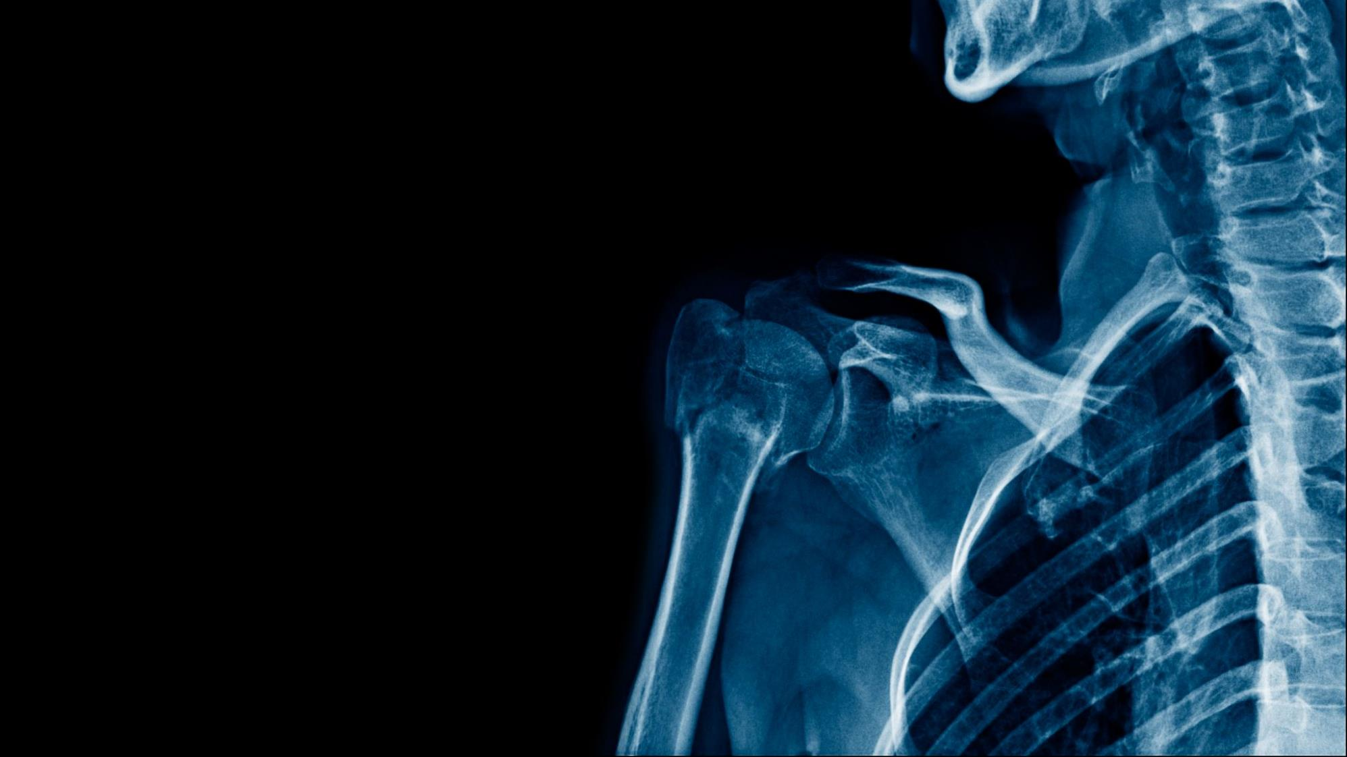
EXERCISES
Check out our exercise suggestions to reduce the negative effects of sedentary work:
Diaphragmatic breathing with flexion-extension spinal mobilization
Spine rotation with hamstring mobilization
Eye accommodation exercises

Slide 39
ADDITIONAL SOURCES
If you are interested in this topic, and want to learn more, check out our recommended sources providing reliable information on health:
Facebook, Instagram and website of “Movement Inspired” - the authors of this module
Health and Safety Executive website
WHO Guidelines on physical activity
Mayo Clinic YT Channel
Podcasts by Dr Andrew Huberman
Prehab Guys YT Channel
Z-Health YT Channel

Slide 40
SECTION
08
Summary of the module

Slide 41
Test what you’ve learned - quiz!
A sedentary lifestyle can be effectively compensated for by: a) massage b) manual therapy c) physical activity d) sleep
When sitting in front of a computer, your eyesight should be at the level of: a) the bottom edge of the monitor b) the center of the monitor c) the top edge of the monitor d) 10 cm above the top edge of the monitor
NEAT specifies: a) increase in back pain b) the amount of energy burned during the day aside from training c) the amount of energy burned during training d) the calorific value of a meal
Insufficient muscle strength can: a) increase spinal fatigue b) cause pain in peripheral joints c) increase the risk of injury d) all of the above
41

Slide 42
Test what you've learned - quiz!
The 20-20-20 rule states to: a) look 20 feet away for 20 seconds every 20 minutes b) do 20 squats and 20 bends after every 20 minutes of sitting c) look at the object at a distance of 20 centimetres for 20 seconds every 20 minutes d) exercise for 20 seconds and then take a 20 second break; repeat the cycle 20 times
The back of your chair should support your: a) head b) upper back c) middle back d) lower back
Intervertebral discs are: a) well supplied with blood b) poorly supplied with blood c) very fragile d) unimportant for the development of back pain
Focusing the eyes on one point for long periods: a) negatively affects eye health b) is a great vision exercise c) improves focus d) strengthens the ciliary muscle

Slide 43
Test what you've learned - quiz!
Correct answers: 1.c 2.c 3.b 4.d 5.a 6.d 7.b 8.a
43

Slide 44
Follow our Journey
www.digiworkwell.eu

