Slide 1
Module 4
Mental Wellbeing
www.digiworkwell.eu

Slide 2
CONTENT OF MODULE 4
01
Learning Objectives
02
Mental Wellbeing in the Workplace
03
A deeper look at digital overload & technostress
04
Work-Life Balance
05
Protecting against the negative impacts of technology
06
Case Studies and exercises

Slide 3
SECTION
01
LEARNING OBJECTIVES

Slide 4
After Studying this Module
Understand the importance of mental health in the workplace and how it can affect employee performance
Understand Digital Overload and identify strategies how to manage it
Reflect on one’s relationship with digital devices by a Digital Well being Assessment
4

Slide 5
SECTION
02
Mental Wellbeing in the Workplace

Slide 6
INTRODUCTION TO MENTAL HEALTH
“Mental Health is as important to our well being as physical health” stated by Ursula von der Leyen, President of the European Commission during the Conference of Future of Europe, 2023
Mental Health is essential to quality of digital work life.
When an individual is in a state of good mental health, the person has a positive outlook and can accomplish daily task and responsibilities and maintain work relationships ( Dr. Dempster, 2022)
6
Notes:
Source:
https://ec.europa.eu/commission/presscorner/detail/en/ip_23_3050
Girolimon, M. (2022). Why is mental health important?. Southern New Hampshire University.
https://www.snhu.edu/about-us/newsroom/education/why-is-mental-health-important

Slide 7
The Future of Work: Rise of Digital Working
According to the World Economic Forum (2023), technology adoption and digitalisation will be a key driver of business transformation in the future. This will lead to a continuous rise of telecommuting jobs and rapid use of digital technologies in the workplace and will have an impact on employees’ mental health.
Human and work performance and mental health go hand in hand. Prioritizing mental health of employees is critical in every organisation, schools, company and institutions.

Slide 8
Benefits of G.O.O.D Mental Health and its Impact on Employees
There are many benefits of having a good mental health state on employees:
G – ain more focus and motivation to work thus boosting productivity levels of employees
0 – perate a positive mindset to deal with everyday work related stress in a changing fast paced digital landscape
0 – pen to collaborating and engaging with colleagues online and offline which can contribute to building a stronger team and communication in the workplace
D- evelop an overall sense of balance and well-being which leads to increase cognitive capacity to learn, and better decision making process in the workplace

Slide 9
Why is Digital Wellbeing Important?
Increased use of technology can be directly linked to mental health issues and disturbance in the human behavior. The excessive use of technology at workplace can lead to burnout. Employers can adopt tools and practices that moderate technology usage to promote healthier life and work.
Digital wellbeing is crucial for businesses as it impacts employee performance, health, and job satisfaction. Prioritising digital wellbeing helps maintain productivity, reduces the risk of burnout, and fosters a positive work culture. Businesses that support digital wellbeing attract and retain talent, promote innovation, and ensure a healthy work-life balance. By implementing strategies that encourage balanced digital use and provide breaks, organisations can create a more engaged, productive, and resilient workforce.

Slide 10
JOMO: Research on Digital Well Being
According to the research conducted by an android team over 112 participants in China, Japan, Singapore, Sweden, and the U.S. over a period of two years, they found out that mobile devices have generated stress and unhealth relationship with the digital device (Aranda, 2018).
“It’s like a prison. You can get lost in your phone and not get out. Social media, gaming, being available [to others] all day… you can’t get away.” Second, people feel that there is a social obligation to reply to messages very quickly, and to be available all the time: “My phone is like a little pet—it goes with me from room to room.
Notes:
Source: https://blog.google/products/android/search-jomo-new-research-digital-wellbeing/

Slide 11
JOMO: Research on Digital Well Being
One of the effective ways to facilitate a healthy relationship with your digital devices like your mobile phones is monitoring how much time you spend on you phones/laptops.
You may look for some tools like a digital timer . When people are aware the on their own usage information, this will pave the way for reflection and action to improve.
Notes:
Source: https://blog.google/products/android/search-jomo-new-research-digital-wellbeing/

Slide 12
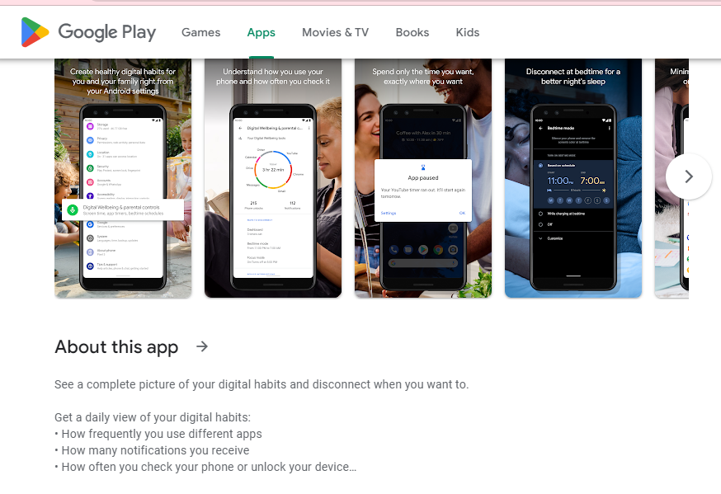
Example: Digital Well Being Application
Notes:
Further links: https://www.androidauthority.com/best-digital-wellbeing-apps-android-3063173/

Slide 13
SECTION
03
A deeper look at digital overload & technostress stress

Slide 14
Digital Overload in the Workplace
As technology makes us more connected, there is a growing concern of Digital Overload in the workplace.
Digital Overload is when we are faced with too much information from digital devices. This overload occurs when the quantity of communication exceeded our capacity to process it.
Digital Overload is a form of cognitive exhaustion that comes from being relentlessly bombarded with interruptions in the form of notifications, emails, instant messages and texts.
These distractions disrupt the flow of work and train of thought, making it difficult to focus. This can lead to technostress, which refers to an individual’s inability to cope with technology related demands in their work environment.
A recent (2020) Eurofound study confirms the above. For example, highly remote workers report higher levels of anxiety, stress and fatigue than their office-based counterparts.

Slide 15
Diagnosing Digital Burnout
The following are signs and symptoms that an employees is experiencing digital burnout (Meyer, G, 2023):
Pessimistic outlook in life and work
social anxiety
Depression
Restlessness or difficulty falling asleep
diminished interest and motivation in job
feeling of stress and worry about work
Declining work performance
Poor quality of work outputs
Notes:
Source:
Meyer,G (2023). What is Digital Overload and How to Prevent it?
https://nbold.co/what-is-digital-overload-and-how-to-prevent-it/

Slide 16
7 Signs of remote worker exhaustion
Here are seven things you can look out for that may indicate your employee is feeling disconnected from their job:
Misses deadlines or is producing substandard work
Stops offering input
Calls in sick or changes their schedule
Does not interact with colleagues
Absent from meetings
Only talks about work
Not interested in career development

Slide 17
Factors of Digital Burnout and Stress
Isolation: One of the significant challenges of remote work is the potential feeling of isolation. Remote workers often miss out on the casual interactions and camaraderie that come with an office environment. This lack of face-to-face interaction can lead to feelings of loneliness, disconnection, and being out of the loop, all of which can erode a worker's sense of belonging and engagement with the team and the organisation.
Overwork: Without the clear structure of an office environment and traditional work hours, remote workers might find themselves working beyond their standard hours. The blurred lines between "work time" and "personal time" can lead to prolonged periods of work, with little rest, causing fatigue, stress, and eventually burnout.

Slide 18
Factors of Digital Burnout and Stress
3. Lack of Boundaries: In a remote work setting, the line between professional and personal life can often blur. The same space is used for both work and relaxation, leading to difficulty in mentally switching off from work. Without these boundaries, workers may feel they're "always on," leading to exhaustion and a decreased ability to relax and recharge.
4. Communication Challenges: Effective communication becomes even more critical in a remote setting. However, without face-to-face interactions, there's a higher chance for miscommunication. It's easier to miss out on non-verbal cues like body language or tone of voice in virtual meetings, which can lead to misunderstandings. Also, there is the potential for feeling left out of essential communications, not being updated about changes, or missing spontaneous brainstorming sessions that happen organically in an office.

Slide 19
Take the Digital Wellbeing Assessment!
Digital Overload and Technostress can form due to several common reasons. As part of the DigiWorkWell project, we have developed a Digital Wellbeing assessment that will give you tailored results of where your organisation stands with its digital wellbeing approach.
Click here for a link to the assessment

Slide 20
Managing Digital Overload and Stress
Below are six ways that you can help to reduce digital overload in yourself and your employees:
Set Clear Boundaries
Encourage remote workers to establish and maintain a designated workspace, set specific work hours, and communicate them to family or housemates. This creates a separation between "work time" and "personal time."
Promote Regular Breaks
Taking short breaks throughout the day can be refreshing. Use techniques like the Pomodoro Technique, where work is broken into short intervals (e.g., 25 minutes) followed by a 5-minute break.
Encourage Social Interaction
Loneliness can contribute to burnout. Create opportunities for remote workers to connect, such as virtual coffee breaks, team-building activities, or chat channels dedicated to non-work topics.
Provide Mental Health Resources
Make sure remote employees have access to mental health resources or counseling services. Regularly share tips on maintaining mental well-being
Offer Flexible Schedules
Everyone has different peak productivity times. Allowing flexible working hours can help workers manage their energy and align their work schedules with their personal rhythms.
Regular Check-ins
Supervisors should schedule regular check-ins with remote employees, not just to discuss work but also to gauge how they're feeling and coping. Listening to their concerns and providing support can make a significant difference in their well-being.

Slide 21
Video: How to Manage Digital Overload
.
Notes:
Link:
https://www.youtube.com/results?search_query=strategies+to+fight+digitial+overload

Slide 22
SECTION
04
Work-Life Balance

Slide 23
Work Life Balance in the Digital Era
In a digital era where technology integrates every part of our lives, where we can be accessed anytime and anywhere, finding a healthy work life balance between has become a challenge. According to Rosen, a pioneer in the “psychology of technology”:
"So many technological innovations have enhanced our lives in countless ways, but they also threaten to overwhelm our brain’s goal-directed functioning with interference. This interference has a detrimental impact on our cognition and behaviours in daily activities. It impacts every level of our thinking, from our perceptions, decision making, communication, emotional regulation, and our memories."
Notes:
Source:
Bishop I (2022). Digital Exhaustion: Redefining work-life balance
https://enterprisersproject.com/article/2022/5/digital-exhaustion-work-life-balance
PAW Research Center (2021). The Internet and the Pandemic
https://www.pewresearch.org/internet/2021/09/01/the-internet-and-the-pandemic/

Slide 24
Work Life Balance in the Digital Era: 3 Tips
Therefore, creating strategies to manage work life balance is the next step to have a good mental health. The following are tips from Dr. Kokshagina, a Research Fellow in innovation and entrepreneurship at RMIT University.
Stop multitasking. Focus on One.
Research showed that the more we switch tasks, we lose our focus on the work that we do.
2. Make timeblocks for specific tasks to
Behavior experiments showed that checking emails on a shorted period of time (time blocks) experience less stress and increases concentration
3. Limit unnecessary communication
Remember that too much information becomes a distraction
Notes:
Source:
Kokshagina,O (2021). Too much information: The COVID work revolution has increased digital overload.
https://www.rmit.edu.au/news/all-news/2021/jan/digital-overload

Slide 25
Tips for switching off when working digitally
1. Don’t add work to your phone
While this might seem difficult, there are so many ways that your colleagues can contact you having you really don’t need to have everything from work on your phone.
Try logging out of your emails and only accessing them during work hours. Whenever we send an email, generally we don’t expect an instant reply, so we will happily wait till the next working day for a response.

Slide 26
Tips for switching off when working digitally
2. Turn on ‘do not disturb’
As too many notifications is one of the most common issues that can cause digital burnout, one of the best techniques for reducing technostress is to turn off push notifications on your phone. The ‘do not disturb’ setting also turns off notifications.
Let’s take this one step further to help you switch off- use the ‘do not disturb’ setting on your phone. You can decide what breaks into your ‘do not disturb’ so you don’t miss important phone calls, but it can block notifications for texts, apps and emails.

Slide 27
Tips for switching off when working digitally
3. Minimise discussion of work at home
Outside of reducing work notifications demanding attention, there are other strategies to switch off and become more present at home.
It can be beneficial to briefly discuss the day upon arriving home. While it's natural to share daily experiences, it's vital to recognise how certain work conversations may induce stress or negativity.
After particularly difficult or stressful days, revisiting these moments might inadvertently transfer negative energy into the home. It’s recommended to limit work-related discussions at home to maintain a separation and aid in disconnecting from work.

Slide 28
Tips for switching off when working digitally
4. Develop an evening ritual
Mindfulness can help to alleviate some of the stresses we face at work, but sometimes there are other things we can do to help reduce the impact of technology. In this case, take the time to do something else, whether it’s a new class or hobby, an evening run or just a new at-home ritual.
Everyone feels like they couldn’t possibly fit any more into their day, but the truth is, if you really want to, you’ll find the time.

Slide 29
The Right To Disconnect
Digital technologies have made it possible for many workers to carry out their work at any time and anywhere, with consequent advantages and disadvantages.
The right to disconnect is a proposed human right regarding the ability of people to disconnect from work and primarily not to engage in work-related electronic communications such as e-mails or messages during non-work hours.
The modern working environment has been drastically changed by new communication and information technologies. The boundary between work life and home life has shrunk with the introduction of digital tools into employment. Every country is following the right to disconnect, among which a few do not have a specific law relating to the same concern.
Click here for a link to see how different EU countries are approaching the right to disconnect

Slide 30
SECTION
05
Protecting against the negative impacts of technology

Slide 31
Equipping Ourselves Against The Negatives Of Technology.
While is it very easy to focus on the negatives of digital technologies, they are a crucial part of modern-day life. Most of us will use multiple digital technologies throughout our day-to-day tasks.
It is important to equip ourselves with the correct understanding of the dangers of digital technology, but it is also important to have techniques and methods to ensure that we can continue using digital technologies in a safe way.
Let’s take a closer look at some of the negative effects of digital technology use and how to avoid them.

Slide 32
Digital Distraction
Digital Distraction is when you use a digital device (smartphone, laptop, tablet) whilst you engage in another activity. It occurs when digital devices are used for activities unrelated to class time or work time. This often includes text messaging, emailing, web-surfing, using social media, and playing games.
Due to the digitalisation that the pandemic brought on, it is easy to slip into the habit of checking your phone while working.
One of the best ways of managing digital distraction is to temporarily disconnect from technology, which leads to fewer digital distractions.
While the ability to multitask is seen as a positive trait for many, it is also a major source of digitally-induced stress that can be controlled, once we have gotten into the habit of taking breaks.
Let’s take a look at some research conducted in the US to help manage digital distraction.

Slide 33
Digital Distraction findings
Here are some surprising findings from research conducted to help workers with digital distraction:
20% of employees want their employer to help them control their digital distraction during work.
25% of industrial workers want their employer to help them with this.
More than 50% of employees who were working from home due to COVID say that they spend even more time than they used to during work hours socializing with family and friends via social media, text, email, and calls.
The average person at their workplace spends 2.6 hours each workday accessing digital content that is unrelated to their job​

Slide 34
Digital Distraction Findings
Here are some surprising findings from research conducted to help workers with digital distraction:
26% say there have been accidents in their workplace caused by smartphone distraction​
58% said their employer has a policy restricting personal smartphone use during work hours
27% wish their employer would assist them in reducing their smartphone use during work hours
​​10% say there have accidents in their workplace caused by smartphone distraction

Slide 35
What is an Attention Span?
An Attention span is the time a person can focus on a task before they feel the need for a break or get distracted.
This amount of time can vary on the person. It is difficult to pin down an exact amount of time for each person’s attention span, as it can depend on the complexity of the task, and the natural cognitive abilities of each person.
Ensuring that your workers can do their daily work without getting distracted can improve productivity, and help to alleviate symptoms of burnout and stress.

Slide 36
Digital Technology and Attention Span
Digital technology impacts the attention span in several different ways.
Information recall- using internet search engines can lead to poorer recall of information. Most researchers agree that in such situations it is not that memory becomes less effective, just that we use it differently.
Potential other harmful effects of extensive screen time and technology use include heightened attention-deficit symptoms, impaired emotional and social intelligence, technology addiction, social isolation, impaired brain development, and disrupted sleep.

Slide 37
Improving Attention Span in Workers
Here are few suggestions on employees can improve their attention span:
Practice attentive listening. One way we can stretch and hone our attention span is to practice active, attentive listening. This helps focus the mind’s ability to receive and absorb information.
Devote more time to reading. Another way to hone our mind’s ability to concentrate is by attentive reading.
Physical activity. One other way to increase our attention span is to get moderate levels of exercise.

Slide 38
Stress and loss of focus
Lack of concentration leads to the inability to meet deadlines, increased work pressure and thereby increased stress and ill health. There could be many reasons why employees lose focus. A reflection of these causes may help us focus and enhance our productivity at work.
Very often, stress may be the reason behind their inability to concentrate. There may be many things on our mind preventing us from concentrating properly.

Slide 39
How to Manage a Loss of Focus
Firstly, organisation is key. Set a priority list of work, plan schedules beforehand and attend to each task one by one.
Try not to multitask at such times. Instead, concentrate on the most important job, finish it and then move to the next task. This way, no job is kept for the last minute.
If employees are still struggling to stay focused, or are getting distracted, it may benefit to mentor employees for a short time to ensure that they understand how they can complete their workload without losing focus.

Slide 40
Multitasking
Multitasking seems like a great way to get a lot done at once, but research has shown that our brains are not nearly as good at handling multiple tasks as we like to think they are.
In fact, some research suggests that multitasking can hamper our productivity by reducing our comprehension, attention, and overall performance.
People who multitask are more distractible, and they may have trouble focusing their attention even when they're not working on multiple tasks at once.
Follow these simple steps to make workdays less stressful:
Do one task at a time
Don't start on a second task before the first one is completed
Start with the simple and short things first
Stay away from phone while working or keep it on silent
Monitor stress levels and take a break when needed

Slide 41
SECTION
06
Case Studies and Activities

Slide 42
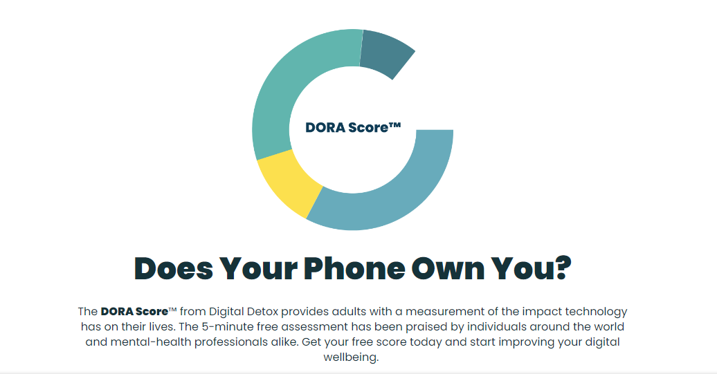
DORA Assessment: Does your Phone Own you Test
.
Notes:
Link: https://www.digitaldetox.com/score/

Slide 43
“Digital Well Being is about crafting and maintaining a healthy relationship with technology” – Greta Rossi, Co founder of Recipes for Well Being
43

Slide 44
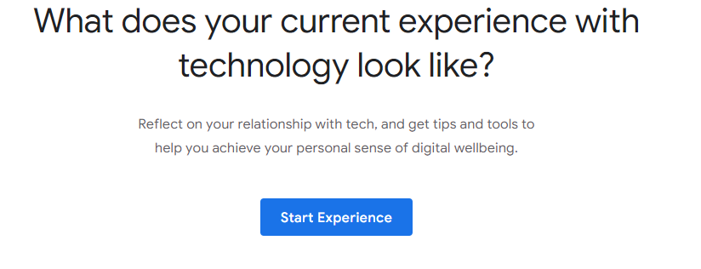
Assessment: Reflect on your Habits
.
Notes:
Link: https://wellbeing.google/

Slide 45
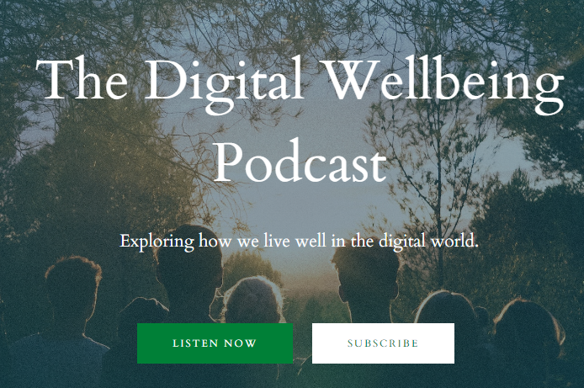
Listen to Digital Well Being Podcast
.
Notes:
Link: http://thedigitalwellbeingpodcast.com/

Slide 46
Case Study: Vodafone- “Digital Detox Days”
Introduction
The Vodafone case study presents a compelling example of how modern organisations are grappling with the challenges posed by the digital era. This case study is particularly relevant in the context of increasing concerns over employee well-being in the face of relentless digital connectivity. Vodafone, a prominent player in the telecommunications industry, recognized two significant challenges impacting its workforce: the rise in employee burnout and stress due to constant digital engagement, and the need for a healthier work-life balance in an industry that is notoriously fast-paced and 'always-on’.
Challenge
The challenge faced by Vodafone was two-fold. First, the constant use of digital devices and the pressure to be always available had led to an increase in employee burnout and stress. This not only impacted individual well-being but also had the potential to affect overall employee productivity and satisfaction. Second, Vodafone needed to find a way to create a healthier work-life balance in an industry known for its fast-paced and always-on nature. The challenge was to strike a balance between maintaining productivity and ensuring employee well-being

Slide 47
Case Study: Vodafone- “Digital Detox Days”
Solution
Vodafone's innovative solution was the introduction of "Digital Detox" days. This policy encouraged employees to take designated days off from work-related digital devices, including smartphones, laptops, and tablets. The aim was to provide employees with a break from the constant barrage of digital notifications and allow them to truly disconnect during their time off. During these detox days, employees were encouraged to engage in non-digital activities, spend time with family and friends, and focus on their personal well-being.
Implementation
The implementation of the "Digital Detox" policy at Vodafone was a phased approach. The company started by raising awareness about the importance of digital well-being and explaining the benefits of disconnecting from work-related digital devices. They provided guidelines and recommendations for employees on how to effectively utilise their detox days. Importantly, Vodafone created a supportive culture where employees were not penalized for disconnecting, and managers were encouraged to set an example by participating in the initiative.
As a result of the "Digital Detox" initiative, Vodafone saw positive outcomes. Employees reported reduced stress levels, improved work-life balance, and enhanced overall well-being. The company also observed a reduction in burnout-related absenteeism and an increase in employee morale and engagement. Vodafone's commitment to addressing digital burnout through innovative policies like "Digital Detox" showcased their dedication to the well-being of their workforce while maintaining their competitive edge in the telecommunications industry.

Slide 48
Key Takeways
Mental Health and Employees’ Productivity are interconnected. A good mental health state increases productivity and have long term positive impact
Organizations, Schools, Companies should strengthened mental health policy and invest on programs for its employees

Slide 49
Key Takeways
Develop strategies to manage one’s digital well being to achieve a good mental health state
Digital Wellbeing is all about balance and finding a health relationship with technology and digital devices

Slide 50
Take care of your digital self, so that your real self can thrive." - Alexandra Samuel
50

Slide 51
Follow our Journey
www.digiworkwell.eu

